Slide 1



Covid-19 Data Analysis and Visualization using Data science

Slide 2
5132 - Thirumalai Engineering College
Kilambi, Kanchipuram.
Department of Information Technology
Team member
Name
Register Number
S.Tamilselvam
D.Olimani
K.Madhan
513220205006
513220205306
513220205003
COORDINATER
MRS.S. HEMALATHA ME.,

Slide 3
INTRODUCTION
WHO has declared the COVID-19 as a pandemic. A pandemic is defined as disease spread over a wide range of geographical area and that has affected high proportion of the population.
A COVID-19 data analysis and visualization project using data science aims to explore trends, patterns, and insights within pandemic-related datasets.
The project will help us in recognizing the insights that will be gained by using machine learning algorithms on the data.
This interdisciplinary approach combines public health knowledge, data processing skills, and visualization expertise to contribute valuable insights in managing and understanding the ongoing pandemic.

Slide 4
ABSTRACTION
This COVID-19 data analysis and visualization project utilizes advanced data science methodologies to examine and interpret diverse datasets related to the pandemic situation.
It is most contagious in starting of first three days after the onset of symptoms, although spread is even possible before symptoms appear, and from people who do not show symptoms.
The project will help in analysing and recognizing the insights that will be gained by using the Technologies Python and Tableau.
It is used to make all the visualizations which are displayed on the dashboard, these insights will help in identifying and giving an idea of how the number of covid cases are impacted as possibility of being diagnosed positive on the basis of the symptoms.

Slide 5
SCOPE
Predictive the data
Real-time data monitoring
Public health recommendations
Visualization development
Decision making to health sectors.

Slide 6
DATA SET
The dataset selected is Covid-19_line_list_data.
Information provided deals with cases in country, reporting date with respect to countries while also nothing down the symptoms along with recovery and health rate of people.
The objective is to find the age group affected and the place largely affected.

Slide 7
Existing System
As of my last update in January 2023, several existing systems and projects focused on COVID-19 data analysis and visualization using data science techniques.
The status and availability of these projects may have changed, and new projects may have emerged since then.
Some criteria are like Covid-19 dashboard, Covid Data Tracker(CDT), Predict and analysis for approximation and assumption.
These are more critical to analysis the datasets in our project.

Slide 8
Proposed System
To overcome the drawbacks of the existing system, the proposed system has been evolved.
Aggregate and Integration the diverse datasets, covering cases, vaccination information.
These project more developed an interactive dynamic visualization dashboard.
The system provides with the best user interface. The efficient reports can be generated by using this proposed system.

Slide 9
System Requirements
Hardware Requirements
1.Minimum RAM: -4GB
2.Hard Disk: -128 GB
3.Processor: -Intel Pentium 5 or higher.
Software Requirement
1. OS: windows
2. Python IDE: Python 2.7.x and above
3.Jupyter Notebook
4.Visual Studio Code and Tableau
5. Language: Python

Slide 10
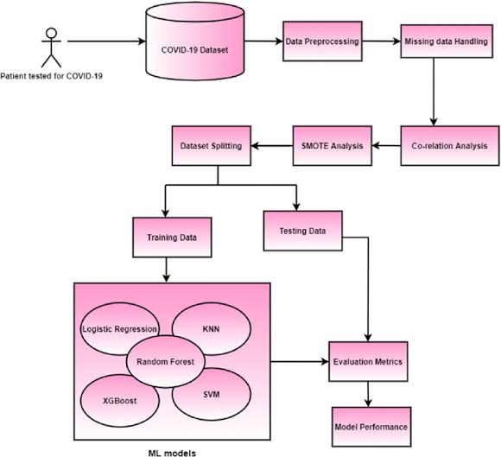
Architecture

Slide 11
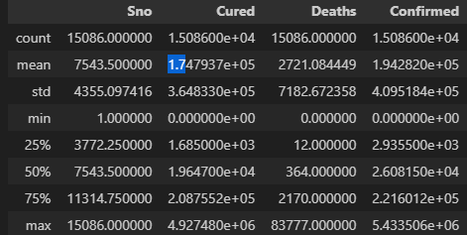
DATA FRAMES
It is the crucial components in Covid-19 data analysis project.
They help organize and manipulate data efficiency.
Python library packages like NumPy, pandas are used for this purpose.
Data Frames accepts many different kinds of inputs.
vaccine_df.info()

Slide 12
MODULES
Module 1: Cleaning the dataset
Module 2: Data Visualization
Module 3: Computing Accuracy
Module 4: Predicting Covid +ve or -ve

Slide 13
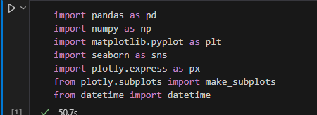
PYTHON PACKAGES
There are several Python packages commonly used for COVID-19 data analysis.
Like NumPy, pandas, seaborn, matplotlib, plotly etc.,

Slide 14
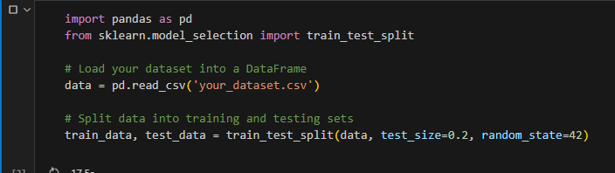
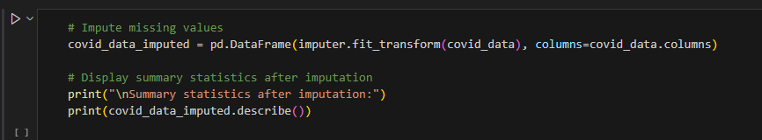
SPLITTING,IMPUTATION AND INTERPOLATION
Splitting – pandas sample() is used to generate sample random row or column from the data frame.
Imputation – The process of replacing the missing data with substituted values.
Interpolation – A method of constructing new data points within the range of a discrete set of know points.

Slide 15
DATA CLEANING
Data cleaning is the process of fixing or removing incorrect, corrupted, incorrectly formatted, duplicate, or incomplete data within a dataset.
When combining multiple data sources, there are many opportunities for data to be duplicated or mislabeled.
Data cleaning or data scrubbing, is the process of fixing incorrect, incomplete, duplicate or otherwise erroneous data in a data set.

Slide 16
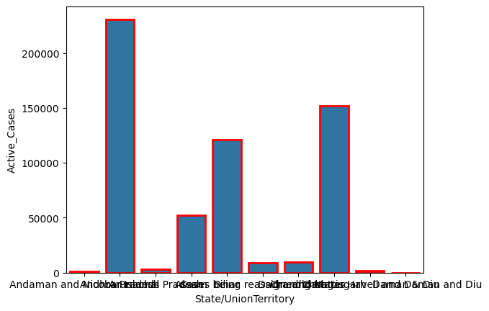
TOP 10 ACTIVE CASES IN INDIA

Slide 17
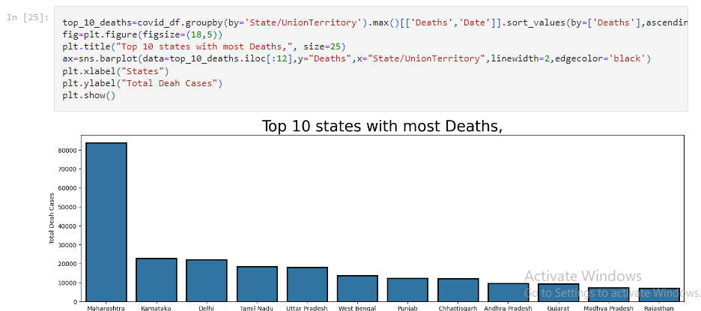
TOP 10 STATES WITH MOST DEATHS

Slide 18
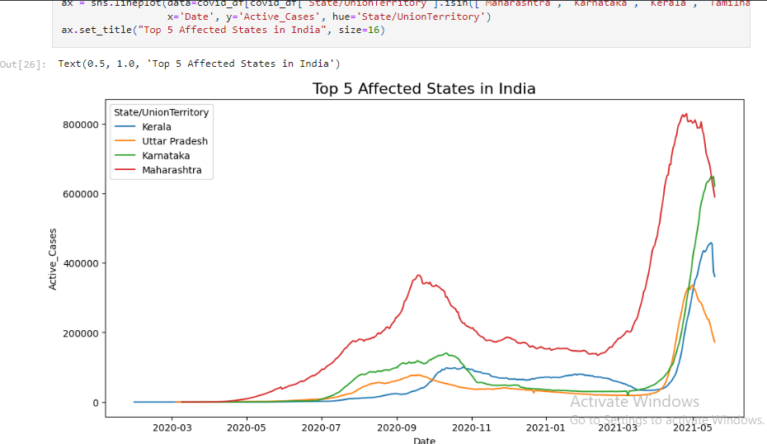
TOP 5 AFFECTED STATES IN INDIA

Slide 19
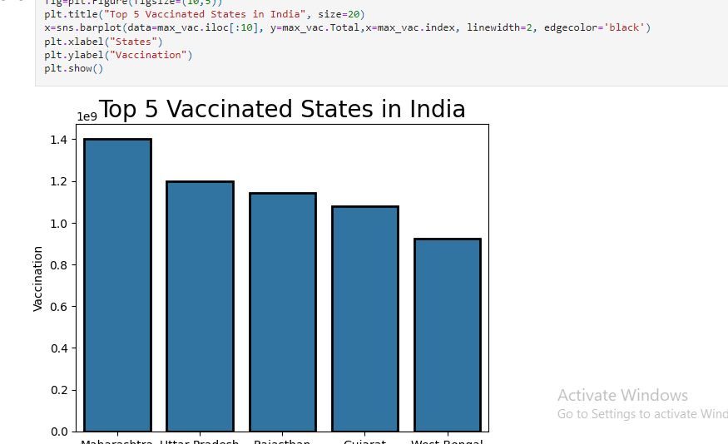
TOP 5 VACCINATED STATES

Slide 20
VISUALIZATION IN COVID 19 DATA ANALYSIS(TABLEU)
Tableau is a powerful tool for creating interactive visualizations.
To create a visualization for a COVID-19 data analysis project using Tableau software like,
1. To create dashboard
2. Connect dataset to visualization
3. To import the dataset
4. Customize the visualization (final look)

Slide 21
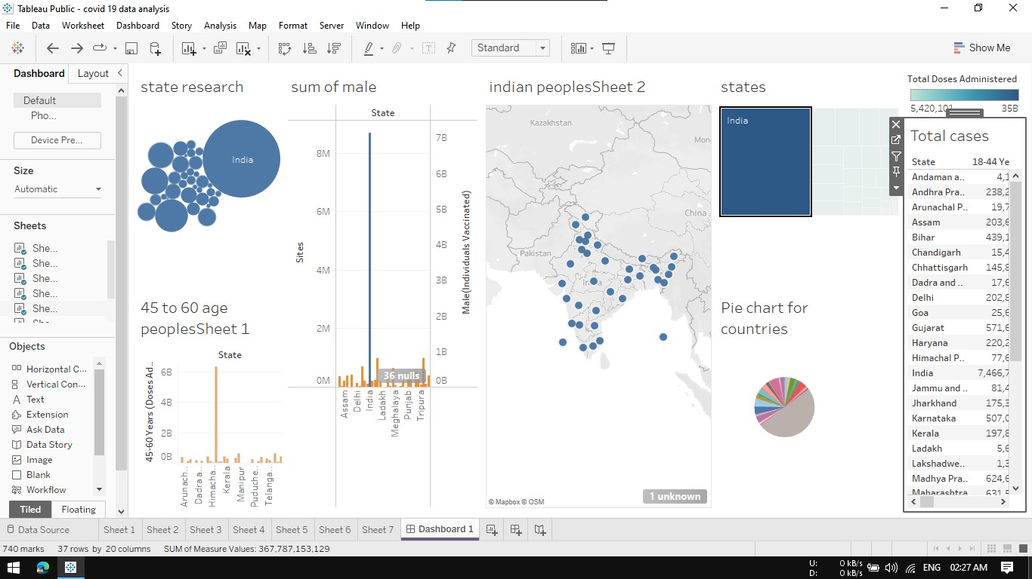
Final Output

Slide 22
Features & Feature Enhancement
1. Features
Global data harmonization
Improved public health Interventions.
Real-time data integration
To analysis complex information
2. Feature Enhancement
The following are the future Enhancement for the project.
1. Mobile App Integration
2. Automated alert system
3. To integrate and collaborate the healthcare systems

Slide 23
Conclusion
In this study the main purpose was to analyse the COVID-19 spread in India since the day of outbreak and pattern of spreading of this virus.
COVID-19 data analysis and visualization projects using data science holds immense potential for advancing our understanding of the pandemic.
With evolving technologies and methodologies, we anticipate more accurate predictive modelling, real-time collaboration, and innovative visualization techniques.
Ultimately, the continued evolution of these projects is instrumental in shaping effective public health strategies, fostering global collaboration, and preparing us for future health challenges.

Slide 24
Reference
1. Lyn Bartram, Michael Correll, Melanie Tory,” Untidy Data: The Unreasonable Effectiveness of Tables,” IEEE Transactions On Visualization And Computer Graphics, Vol. 28, No. 1, January 2022.
2. fshar Shamsi, Hamzeh Asgharnezhad, Shirin Shamsi Jokandan, “An Uncertainty-Aware Transfer Learning-Based Framework For Covid-19 Diagnosis,” IEEE Transactions On Neural Networks And Learning Systems, Vol. 32, No. 4, April 2021.
3. Carson K. Leung, Yubo Chen, “Machine Learning and OLAP on Big COVID-19 Data,” IEEE International Conference on Big Data, Year:2020.
4. Carson K. Leung, Yubo Chen,” Big Data Visualization and Visual Analytics of COVID-19 Data,” 24th International Conference Information Visualization, (2020).

Slide 25


